Slide 1
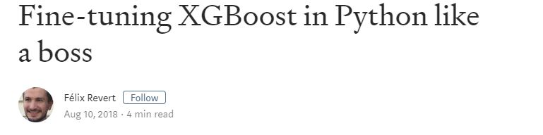

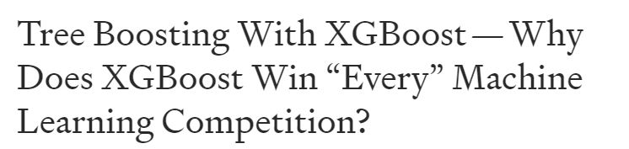
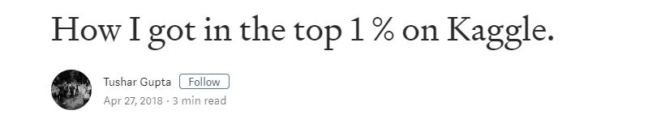
XGBoost: The Excalibur for Everyone!
OR
How to get XGBoost Up and Running in 5 Steps or Less
Notes:
My name is Rika Gorn
My talk is on the XGboost algorithm and library. I’d been hearing about XGBoost all over the Twitterverse and that it wins all the Kaggle competitions and is basically the best algo ever. So I wanted to demystify it and show folks how to implement the model in 5 very easy steps.

Slide 2
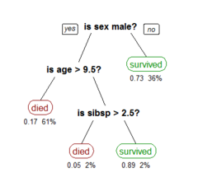
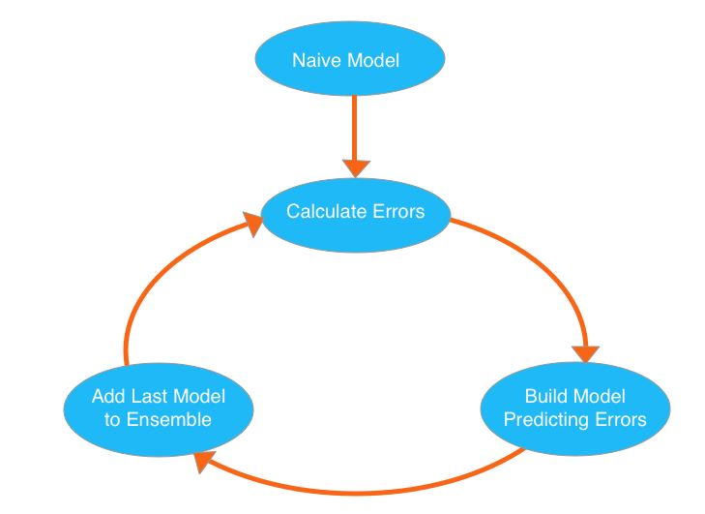
eXtreme Gradient Boosting
Decision Trees
Gradient Boosted Model
Notes:
XGBoost stands for extreme Gradient Boosting and is a combination of 2 other models – the decision tree and the gradient boosted model.
A decision tree is a very easy to understand model that classifies a variable by going through a series of simple decisions?
In the titanic dataset that would be if a person is male, if their age is greater than 9 and a half, and the number of siblings they have. These leaves on a tree can be either continuous or categorical.
A gradient boosted model is another technique for regression and classification that converts weak learners or a weak baseline model to strong learners by building onto previous models and increasing the weights of observations that are difficult to classify or have a high error.
XGBoost puts these two techniques together to create a very fast and very efficient way to work on regression and classification questions.

Slide 3

Step 1:
Feature Selection and Cleaning
library(tidyverse)
library(readxl)
library(here)
library(inspectdf)
library(janitor)
library(xgboost)
Remove redundant or nonsensical features
Remove the target variable!
Create new features after inspecting correlations
Notes:
So lets get started
Load your library and do some feature selection, which is kind of fancy word for cleaning your data in my opinion.
For classification problems it’s important to remove features that are really getting at the same information as that adds noise to your model.
Also don’t forget to remove your target variable – the thing that you’re trying to predict – as that can cause data leakage, where you give your model information that it wouldn’t normally be able to learn on its own.

Slide 4
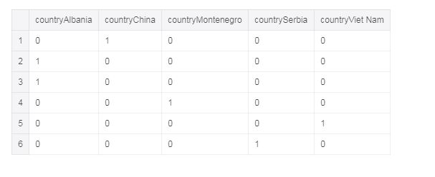
Step 1A: One-Hot Encode Categorical Variables
matrix1_dfnum <- df %>% select_if(is.numeric)
matrix2_country <- model.matrix(~country-1, df)
matrix3_language <- model_matrix(~language-1, df)
training_matrix <- cbind((data.matrix(matrix1_dfnum),
matrix2_country, matrix3_language))
Convert categorical data to numerical values
Combine dataframes and convert to a matrix
Notes:
XGboost takes only numerical values so a major cleaning step is converting your categorical variables into numericals with one-hot encoding. Here’s an example, where the country variable is converted into 0’s and 1’s – this is called a sparse matrix.
Once you’ve converted your variables, put all your important variables or features into 1 giant matrix. The package also has a specific matrix that you can use.

Slide 5
Step 2:
Split Data into 70% Training and 30% Testing
set.seed(42)
sample_num <- round(length(xLabels) * .7)
train_data<- training_matrix[1:sample_num,]
train_labels <- xLabels[1:sample_num]
test_data<- training_matrix[-(1:sample_num),]
test_labels<- xLabels[-(1:sample_num)]
Create 4 files
Training data(matrix)
Training labels (boolean)
Testing data (matrix)
Testing labels (boolean)
Notes:
Next split your data into a training and a testing set. Remember to also split the features and the target variable – which I call the labels here. So you’ll have 4 different data sets to work with. The test and training data will be numerical matrices and the test and train labels with be logicals – so a true or a false for your target variable. I’ve split my data into 70% for training and 30% for testing.

Slide 6
Step 3:
Train Your Baseline Model!
Objective = "binary:logistic": we will train a binary classification model
eval_matrix = root mean square error
nrounds = 2, there will be two passes on the data
model1 <- xgboost(data = train_data,
label = train_labels,
nround = 2,
objective = “binary:logistic”)
[1] train-error:0.019794
[2] train-error:0.018836
Notes:
Now we train our very basic and baseline model. Choose whether you have a regression or classification with the objective and the type of evaluation metric you want to use – here I’m using the root mean square error.
Also, since this is an ensemble algorithm, the model starts building on itself so you have to tell R how many rounds you want to start with – here I’ve gone with 2 rounds and I get a training error, since I’m training on our training data, of .019 for the first round and .018 for the second round.

Slide 7
Step 3A:
Evaluate Baseline
Training Error
[1] train-error:0.019794
[2] train-error:0.018836
Get your error for your model performance
Get predictions for your testing dataset using your baseline model
Testing Error
pred <- predict(model1, test_data)
err <- mean(as.numeric(pred > 0.5) != test_labels)
print(paste("test-error=", err))
test-error= 0.0315477742596387
Notes:
Next we use our baseline model and get predictions on our testing data set – this is the 30% of our dataset that we’ve hidden away from our 1st model. Our error for the testing set here is .03 which is larger than the training error which is pretty normal.

Slide 8
Step 4: Parameter Tuning and Cross Validation
Start with default values and change incrementally
Your knowledge of the data should guide your tuning!
Use CV to optimize parameters until you get the least error
YOUR DATA LOOKS LIKE THIS | PARAMETERS TO TUNE
Has a lot of overfitting | learning rate, subsample, colsample_bytree, min_child_weight
Testing error is way better than training error | gamma (regularization)
Extremely dominant features or unbalanced classes | gamma, scale_pos_weight
A lot of model complexity | learning rate, gamma, alpha, max_depth, lamda
Notes:
The next and most fun step is parameter tuning and cross validation. XGBoost has a ton of parameters to work with, so you can do tuning for a really long time and its important to know when to stop.
A general technique is to start at a default for a handful of parameters and then incrementally increase or decrease them and keep testing your error and cross validating your model – which is a sampling technique to evaluate your model.
The most important thing is to let your data guide your tuning. Really understand your independent variables, how they interact, what the correlations look like with your target variable, use this choose which parameters to tune.

Slide 9
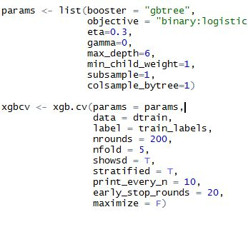
Part 4A: Cross Validation
[1] train-error:0.019854+0.000480 test-error:0.025859+0.002051
[11] train-error:0.015943+0.000477 test-error:0.022747+0.001760
[21] train-error:0.014406+0.000439 test-error:0.022028+0.001578
[31] train-error:0.012870+0.000876 test-error:0.022427+0.001408
[41] train-error:0.010815+0.000852 test-error:0.022188+0.001412
[51] train-error:0.008400+0.000663 test-error:0.022587+0.001499
[61] train-error:0.006485+0.000432 test-error:0.022906+0.001541
[71] train-error:0.004749+0.000573 test-error:0.023066+0.001214
[81] train-error:0.002913+0.000490 test-error:0.023066+0.001188
[91] train-error:0.001676+0.000318 test-error:0.023066+0.001214
[101] train-error:0.000698+0.000363 test-error:0.023465+0.001339
[111] train-error:0.000319+0.000299 test-error:0.023545+0.001065
[121] train-error:0.000120+0.000147 test-error:0.023306+0.000891
[131] train-error:0.000060+0.000049 test-error:0.023226+0.001108
[141] train-error:0.000000+0.000000 test-error:0.023226+0.001453
[151] train-error:0.000000+0.000000 test-error:0.023385+0.001272
[161] train-error:0.000000+0.000000 test-error:0.023066+0.001409
[171] train-error:0.000000+0.000000 test-error:0.022906+0.001082
[181] train-error:0.000000+0.000000 test-error:0.023306+0.001082
[191] train-error:0.000000+0.000000 test-error:0.023226+0.000846
[200] train-error:0.000000+0.000000 test-error:0.023146+0.001095
Notes:
You can then use CV to evaluate each model you train. So here you can see that at round 151 the test-error starts to increase. This tells us to set our nrounds parameter to less than 151. Continue tuning and cross-validating until you have your smallest test error, but know when to stop and let your data guide your process.

Slide 10
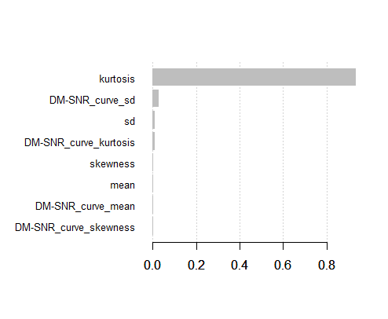
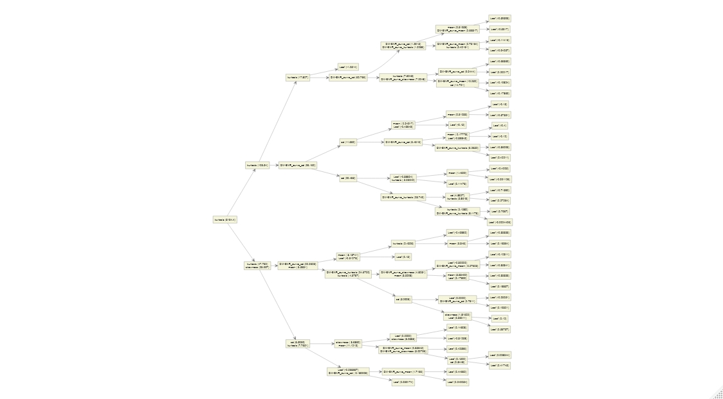
Part 5: Visualize and Interpret
importance_matrix <- xgb.importance(names(train_data), model = model1)
xgb.plot.importance(importance_matrix)
xgb.plot.multi.trees(feature_names = names(train_data),
model = model1)
Notes:
The last step is to visualize your final model. The xgboost package has a lot of nice options for visualizing different evaluation metrics. One is an importance plot which shows which are the most relevant features in your model and tree plot actually visualizes all the branches and leaves in your model.

Slide 11
XGBoost: When, Why, and Why Not?
Pros
Cons
Very Fast
High performance
Useful for Regression and classification problems
Good for overfitting
Good for when working with missing data
A lot of parameter tuning
Less explainable than a decision tree
Not useful for time series or forecasting
Notes:
And that’s it for XGboost in 5 steps. For those that are still skeptical here are some general guidelines for why and when you should use xgboost.

Slide 12


Give XGBoost a try and let me know how it went!
Notes:
So give it a try and let me know how it goes or if you have any questions. There are a ton of online resources and all the code is available on my github.

